Slide 1
SUStech
OOAD
Courschema
midterm
Report
Team Members：
王天麒 11711613
赵志翔 11711621
于志洋 11712819
张艺凡 11711335

Slide 2
Outlines
Topic Implementation
Front-end progress
Back-end progress
Timeline & Future work

Slide 3
Implementation
01
User management module (finished)
User login, User registration, User User monitoring
Favorites module (almost finished)
Query, add, modify, delete favorite subjects
Education program module
1.View education program by year, which shown in tree chart.
2.Students view courses that they have taken
3.Recommended courses, etc.
Q & A module
Students ask questions and department secretary answer
Notification module
Topic
Develop a user-friendly website regarding information of education programs in SUStech.

Slide 4
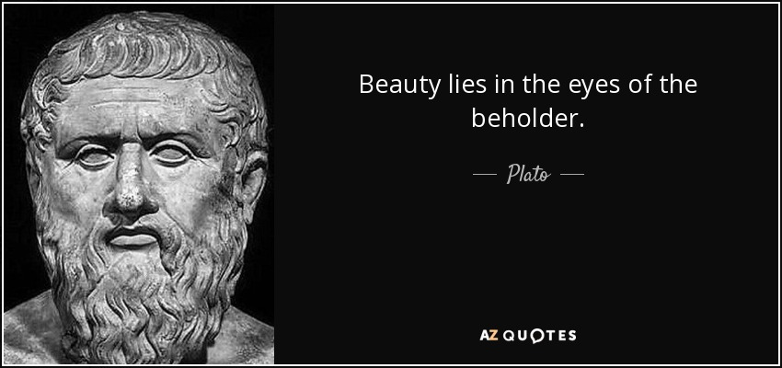
Color
02
Front-End
Design
Philosophy
Principle
Guideline
Clarity is jab
Atomic design
Ockham’s razor
Grid system ( Hit target: at least 44 points × 44 points )
Typography ( Text: font size should be at least 11 points )
Contract, Spacing, High resolution...

Slide 5
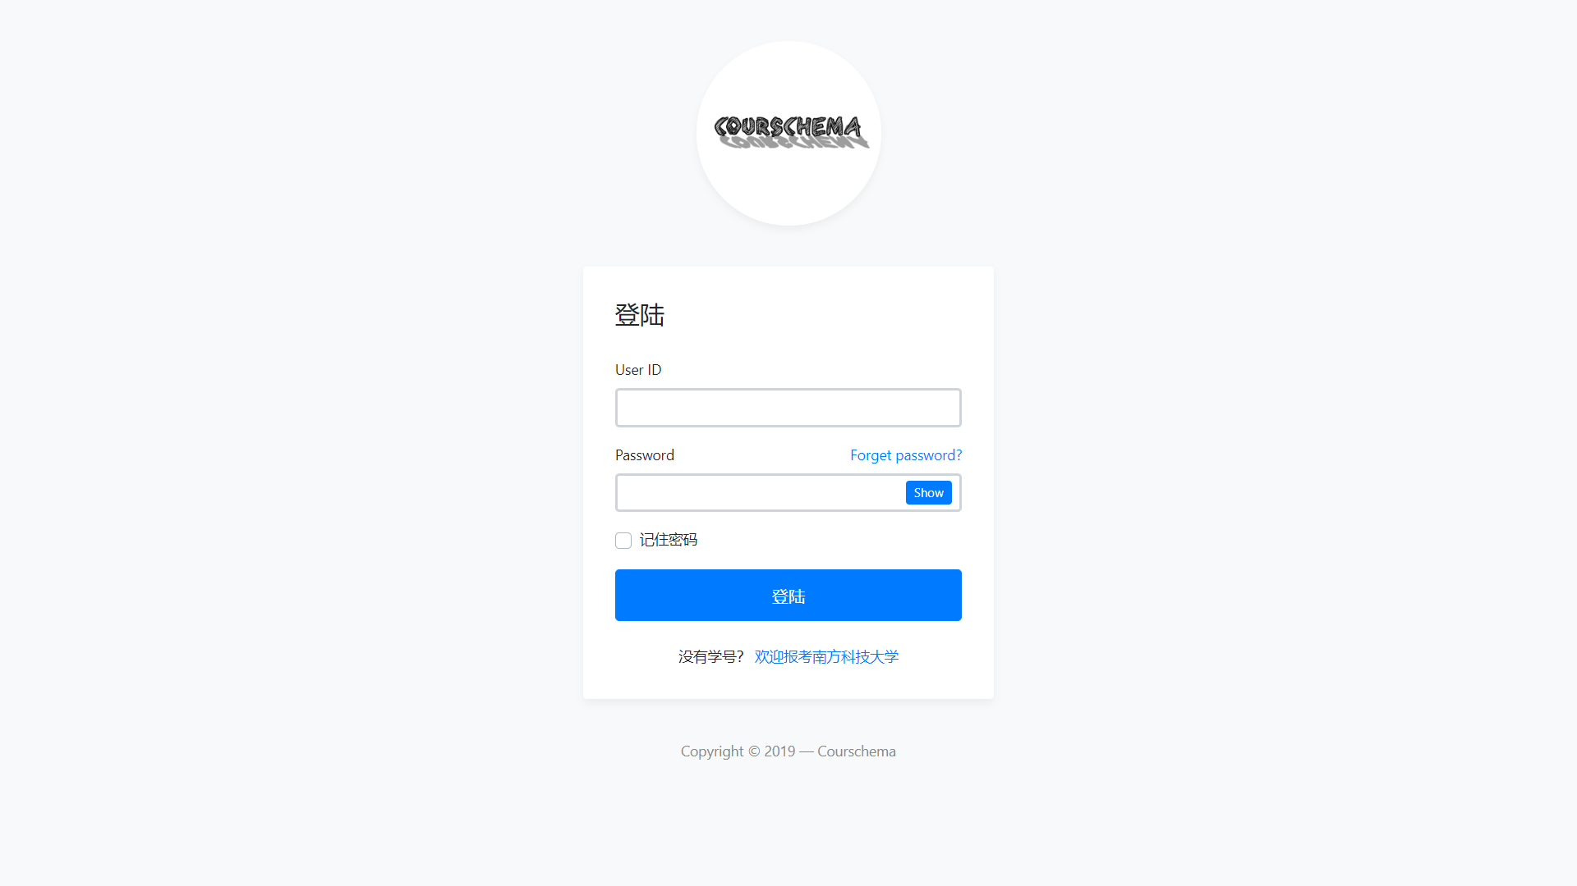
03
Login
1. Determine if the input is empty
2. Does the ID not exist
3. Is the password wrong?

Slide 6
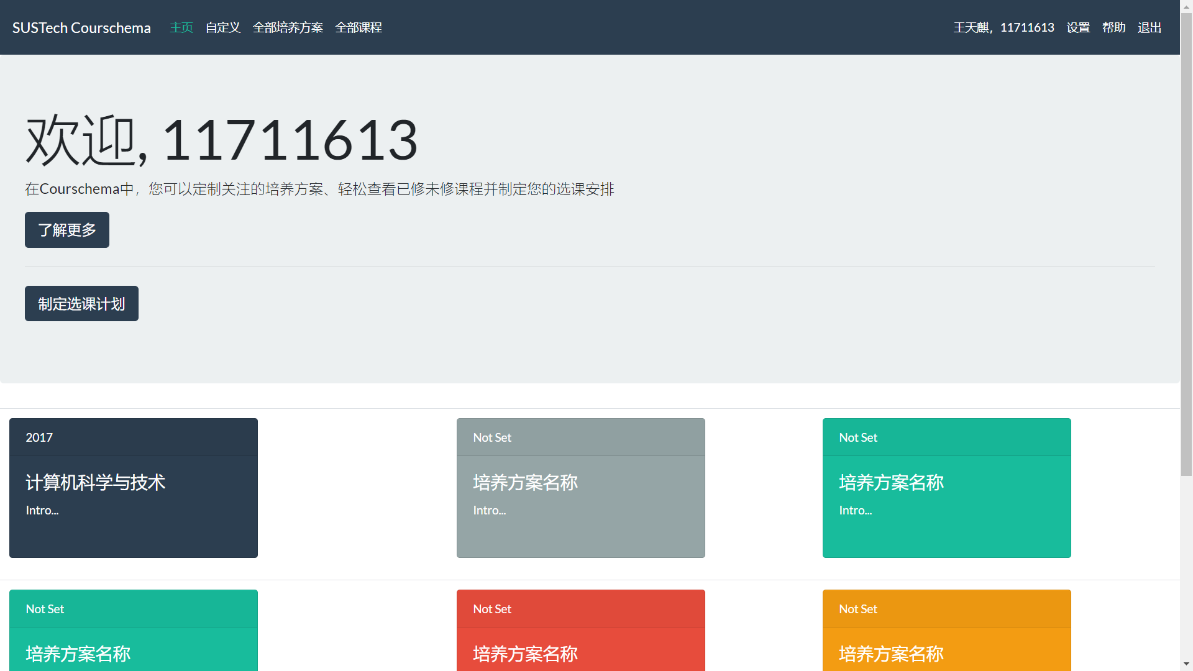

Slide 7
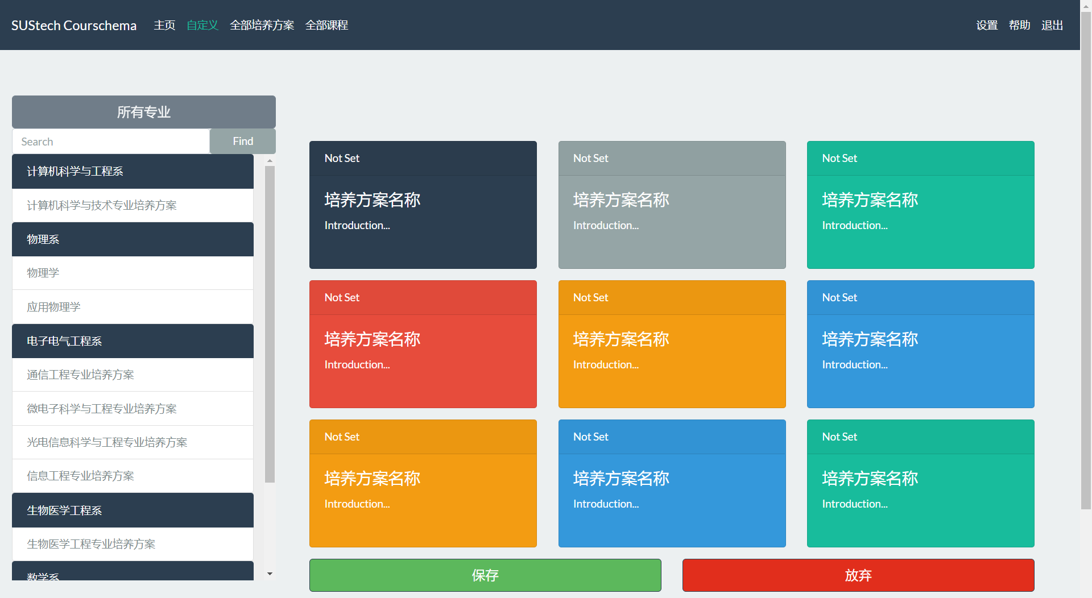
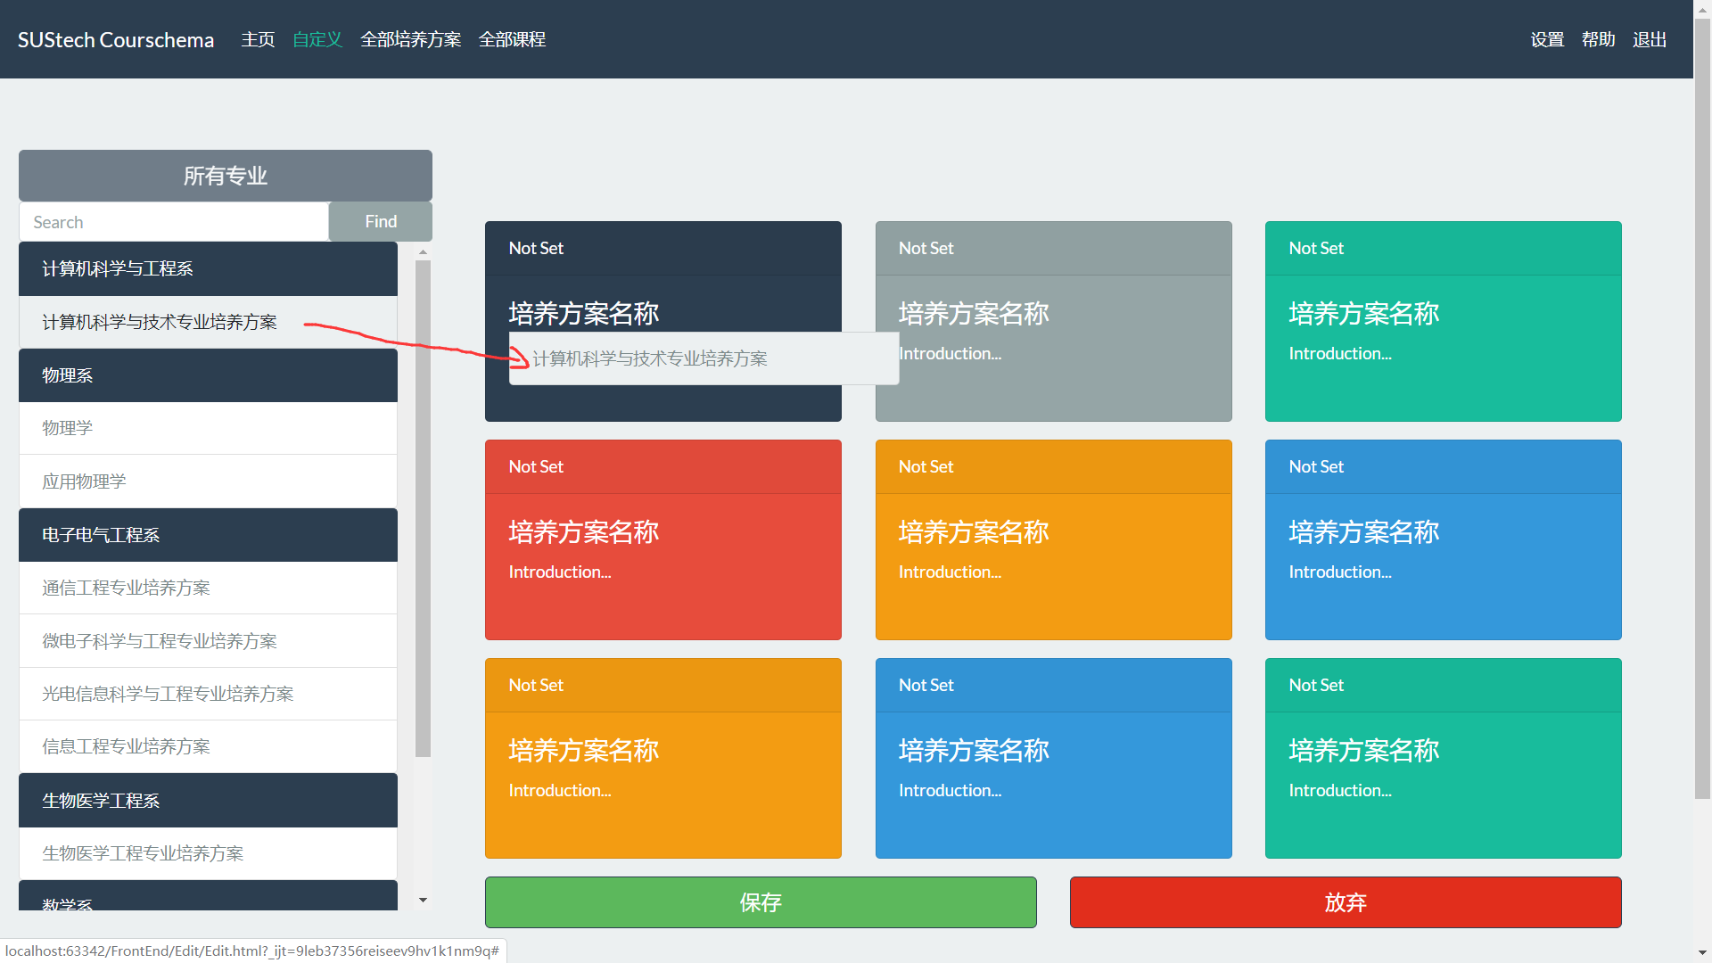
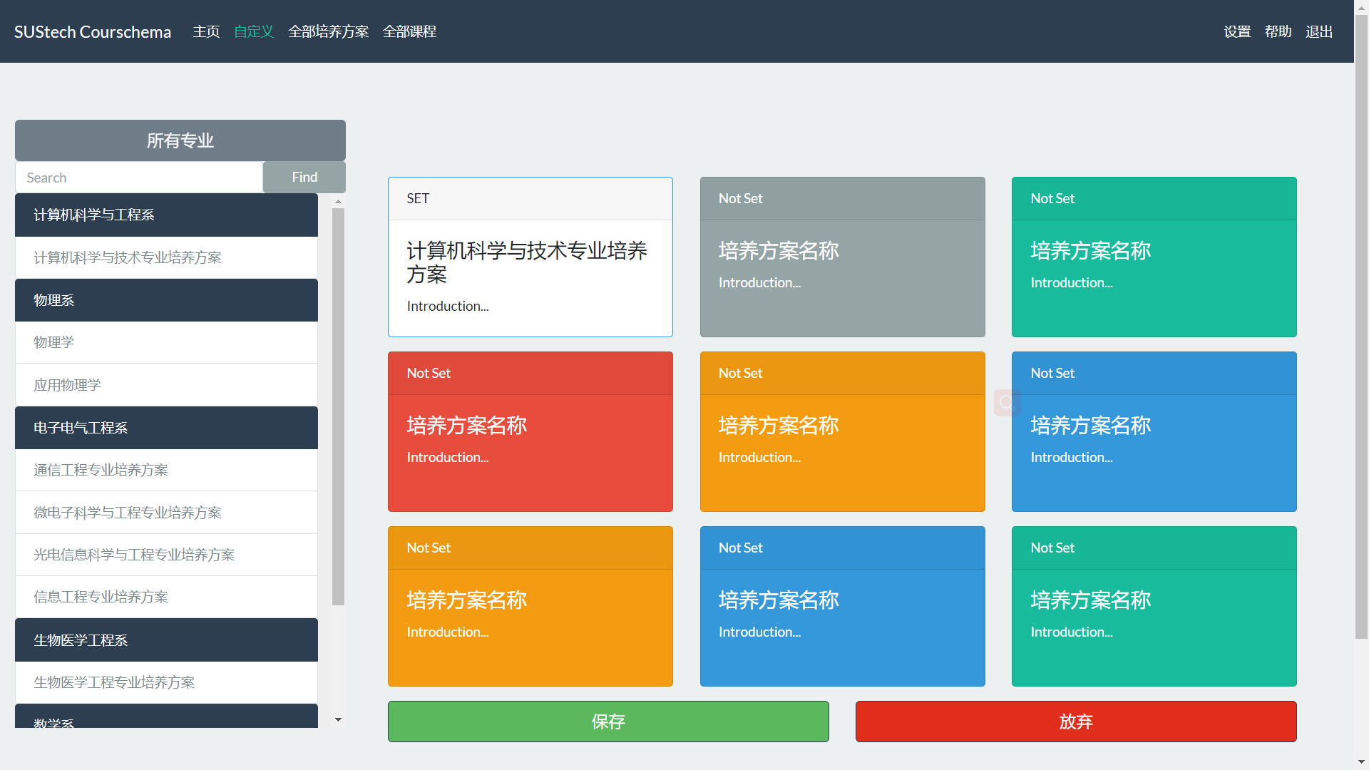
04
1.Drag custom pages
2.Search

Slide 8
URL design
URL | Describe
POST:/user_login | Go to the user page
POST:/education_program_search | Search the education program
GET:/programs_download? Id = {id} | Download the education program
05
Interface document
Example json
URL
Interface document
Interface describe: User Login; URL: POST:/user_login
Parameters: string username, string password, string token;
Respond header: No special response to Header;
Respond parameters: long userid, string sessionkey;
{
“usersession”:
{“userid”:”125”,
”sessionkey”:”21232435353”}
}

Slide 9
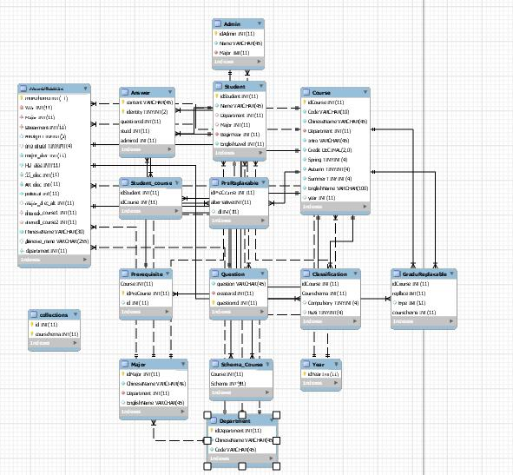
06
Database Design
Data have been imported

Slide 10
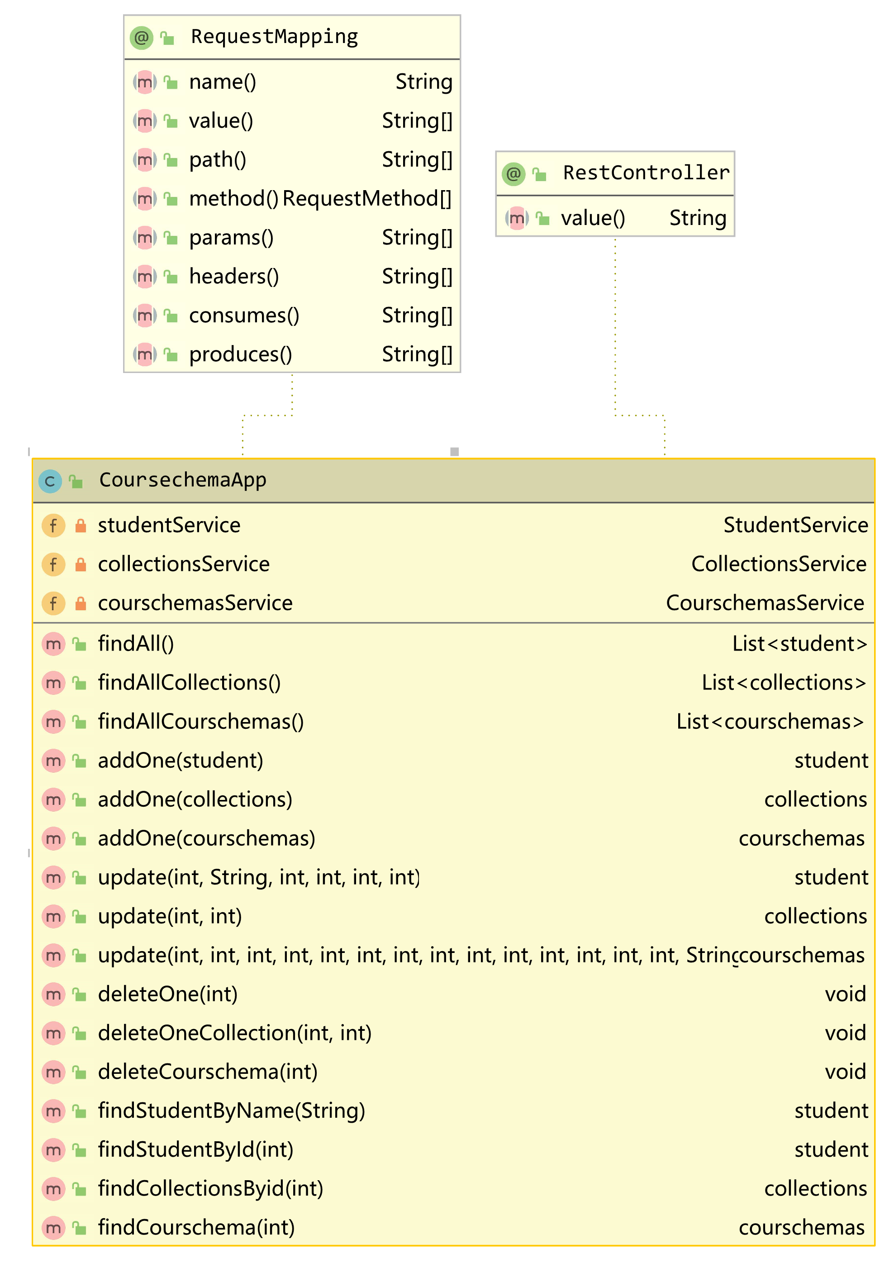
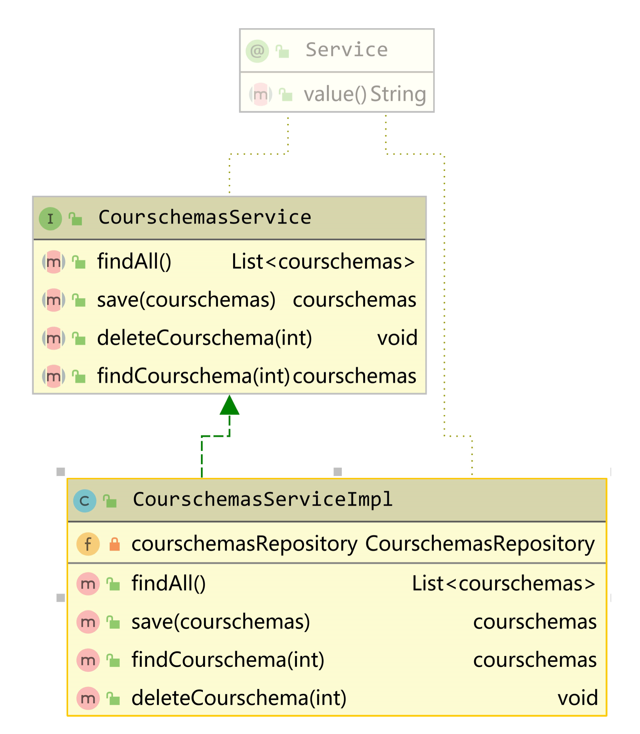
Already implemented function:
search by Student ID, name, checking password and so on.
07
Back-End
Current Progress
MVC frame design
Basic data retrieval

Slide 11
Timeline
03
Week 11-12
Week 13-14
Week
15
Finish the part of Education program module
Finish Q & A module
And Notification module;
Preliminary system test
Test and write final report, final presentation
Timeline
&
Future work
Future work
1. Apply Vue.js to the constructed page and design responsive web
2. Avoid URL redirects as we can as possible
3. Retrive data searched by keyword and pass data to front end
4. Q&A session
5. GUI of major schedule
6. department assistant home page
7.

Slide 12
SUStech
Video
Demo

Slide 13
SUStech
THANKS
For
Listening

